Slide 1
Learn Tableau for DV - FAA wildlife strikes
File created on: 7/26/2022 3:24:58 PM

Slide 2
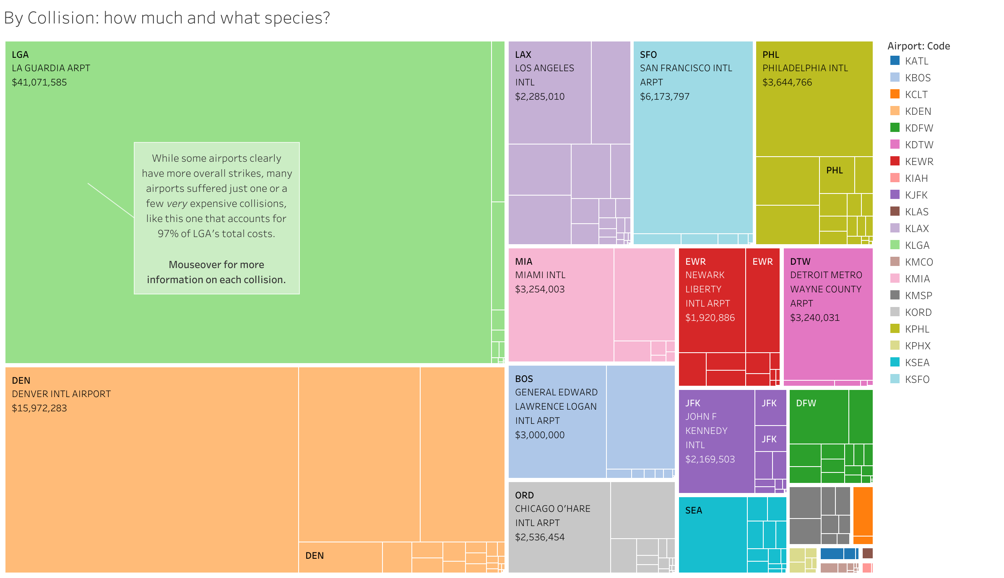

Slide 3
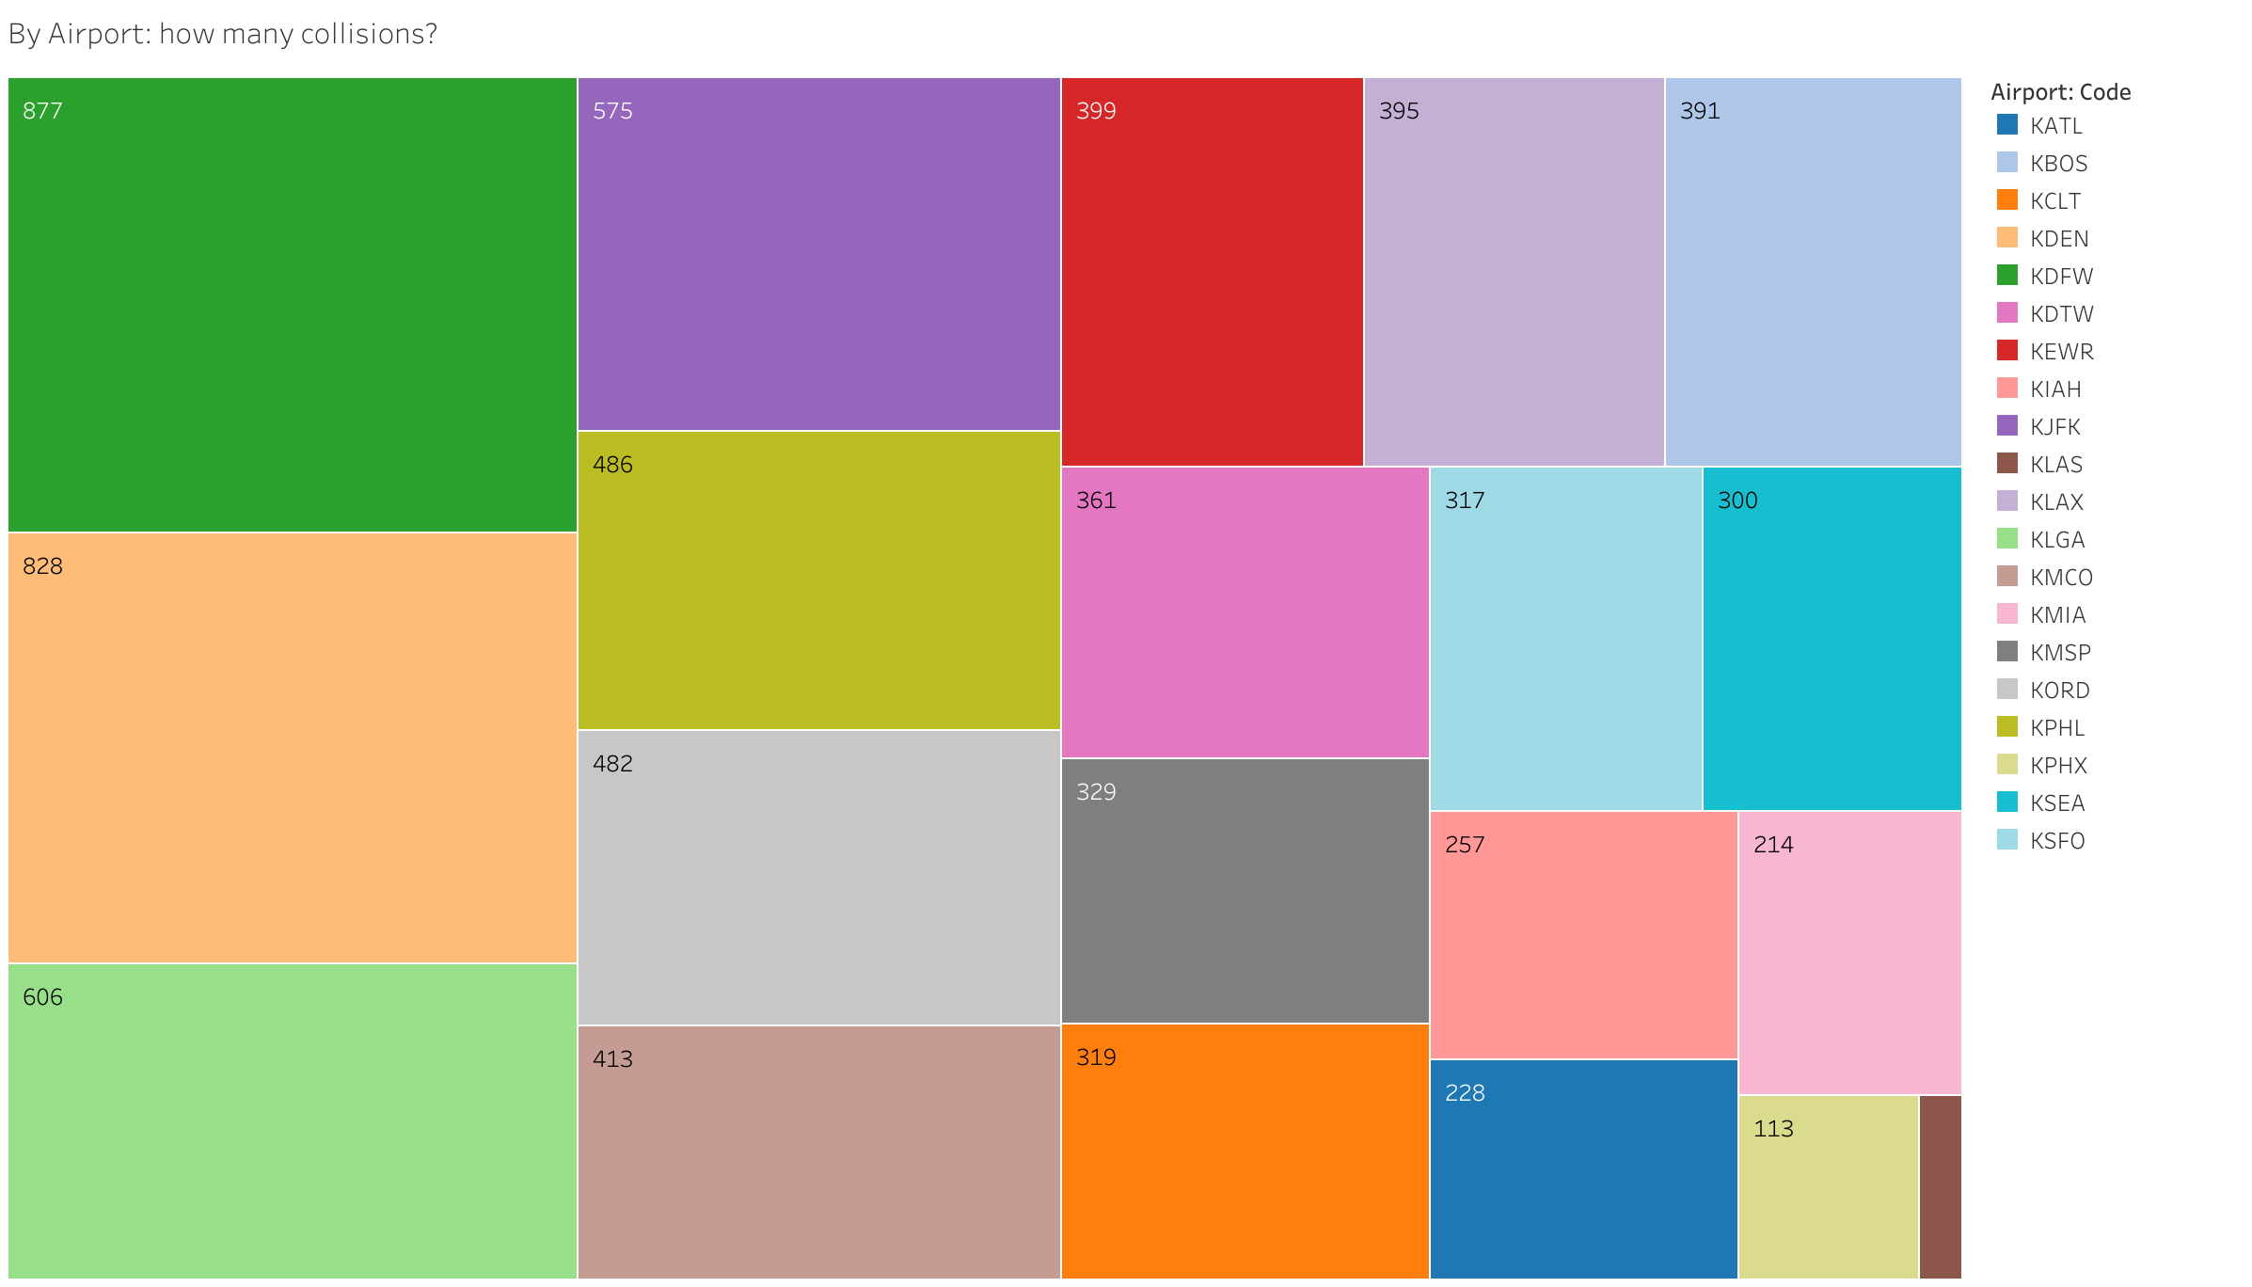

Slide 4
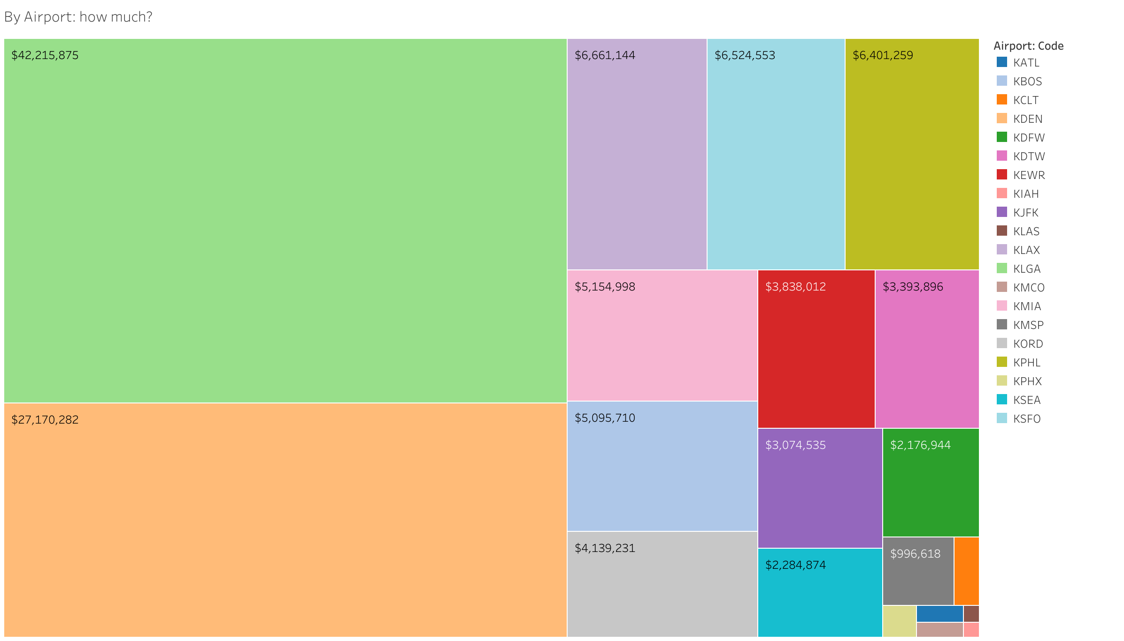

Slide 5
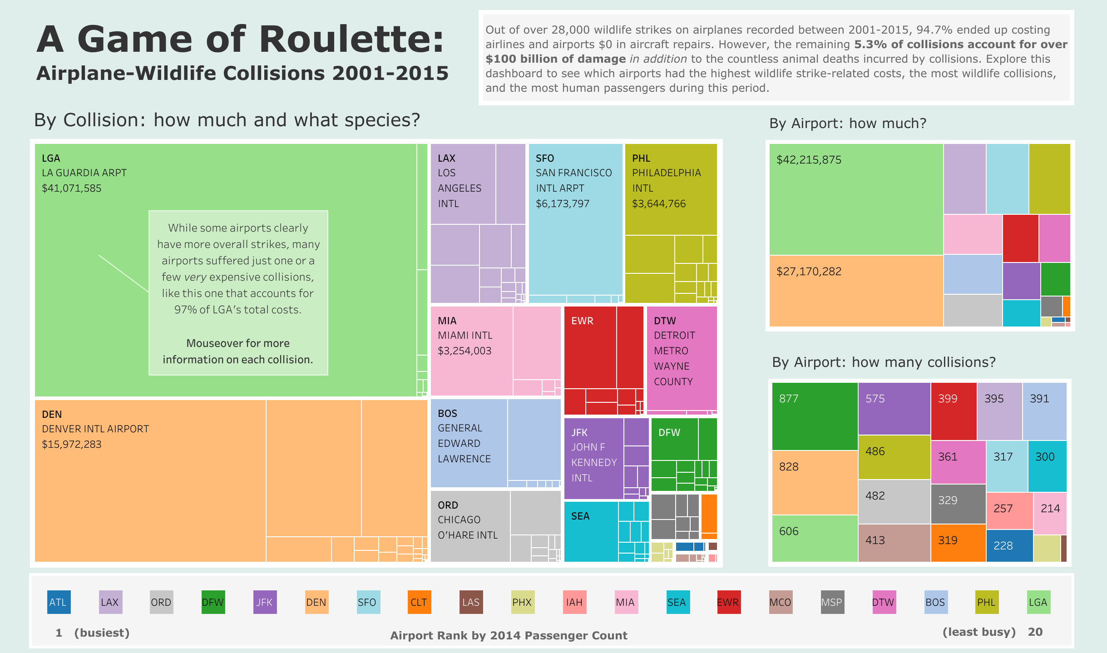

Slide 6
